Slide 1
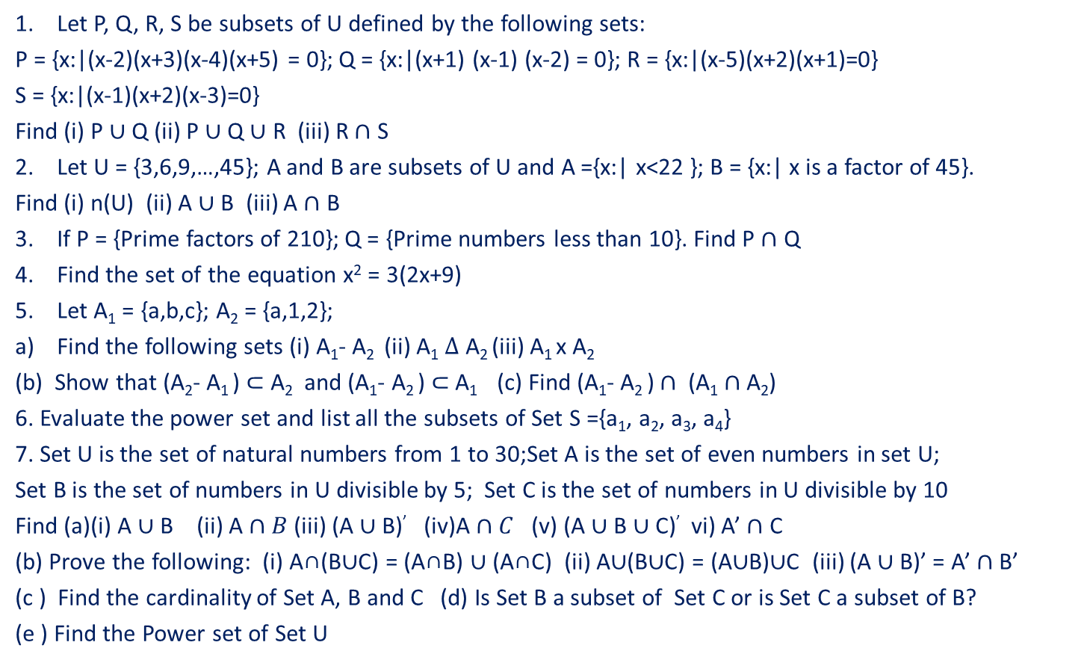
Assignment
Let P, Q, R, S be subsets of U defined by the following sets:
P = {x:|(x-2)(x+3)(x-4)(x+5) = 0}; Q = {x:|(x+1) (x-1) (x-2) = 0}; R = {x:|(x-5)(x+2)(x+1)=0}
S = {x:|(x-1)(x+2)(x-3)=0}
Find (i) P $∪$ Q (ii) P $∪$ Q $∪$ R (iii) R $∩$ S
Let U = {3,6,9,…,45}; A and B are subsets of U and A ={x:| x<22 }; B = {x:| x is a factor of 45}.
Find (i) n(U) (ii) A $∪$ B (iii) A $∩$ B
If P = {Prime factors of 210}; Q = {Prime numbers less than 10}. Find P $∩$ Q
Find the set of the equation x² = 3(2x+9)
Let A₁ = {a,b,c}; A₂ = {a,1,2};
Find the following sets (i) A₁- A₂ (ii) A₁ $∆$ A₂ (iii) A₁ x A₂
(b) Show that (A₂- A₁ ) $⊂$ A₂ and (A₁- A₂ ) $⊂$ A₁ (c) Find (A₁- A₂ ) $∩$ ($\text{A}\text{1}∩\text{A}\text{2}$)
6. Evaluate the power set and list all the subsets of Set S ={a₁, a₂, a₃, a₄}
7. Set U is the set of natural numbers from 1 to 30;Set A is the set of even numbers in set U;
Set B is the set of numbers in U divisible by 5; Set C is the set of numbers in U divisible by 10
Find (a)(i) A $∪$ B (ii) A $∩B$ (iii) (A $∪$ B)’ (iv)A $∩C$ (v) (A $∪$ B $∪$C)’ vi) A’ $∩$ C
(b) Prove the following: (i) A∩(B∪C) = (A∩B) ∪ (A∩C) (ii) A∪(B∪C) = (A∪B)∪C (iii) (A $∪$B)’ = A’ $∩$B’
(c ) Find the cardinality of Set A, B and C (d) Is Set B a subset of Set C or is Set C a subset of B?
(e ) Find the Power set of Set U

